Slide 1
Lab 1 – Intro/Git
CS 506

Slide 2


What are Git and GitHub?
Git is used to manage timelines of a project (a.k.a. the repository)
Git is a version control system
GitHub is a website to backup and host the timeline of your project!
We utilize Git to push updates to our projects to GitHub as a means of backing up our work
For example, if my computer’s SSD becomes corrupted (beyond repair), then I can still access my projects via GitHub!
Additionally, we use Git and GitHub to collaborate on and share projects

Slide 3
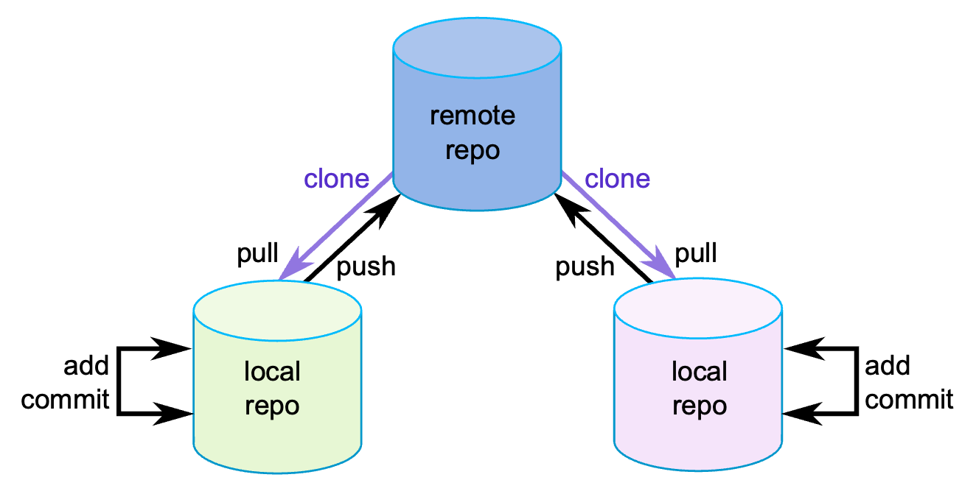
Use case motivation
For each repo/project, I want to write code where:
Iterating on (and keeping track of) different versions of my code is easy
Work is backed up to and hosted on the cloud
Collaboration is seamless!
*
~you/cs506/labs/lab01/
~partner/cs506/labs/lab01/
*Taken from Swarthmore College CS31

Slide 4
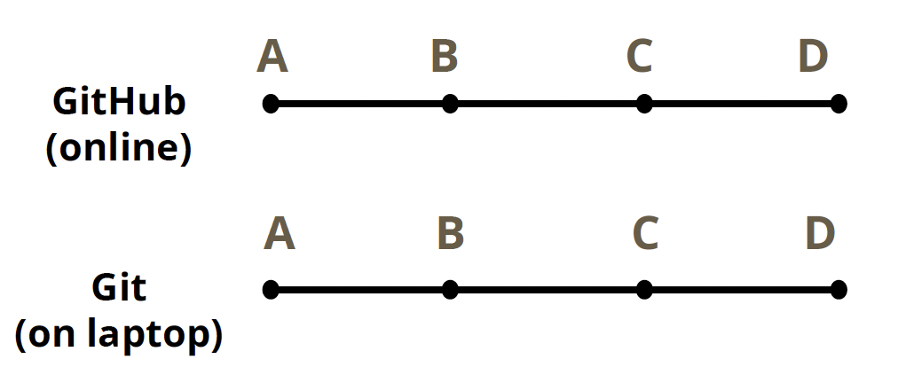
Why do we care about iterating over versions?
Small, incremental commits allow developers (us) to easily rollback or revert to previous, stable versions if errors are introduced.
Commit point: a point in time where we save or “snapshot” our code base
Each commit point is assigned a unique ID, known as an SHA or hash
Unique ID allows us to refer to each state at any time
The ability to iterate over versions also allows us to reconcile our local codebase with the GitHub timeline.
Additionally, we may want to implement a feature on a different version of our codebase.
Question: how do we implement a feature at a previous commit point? The answer is branching!

Slide 5
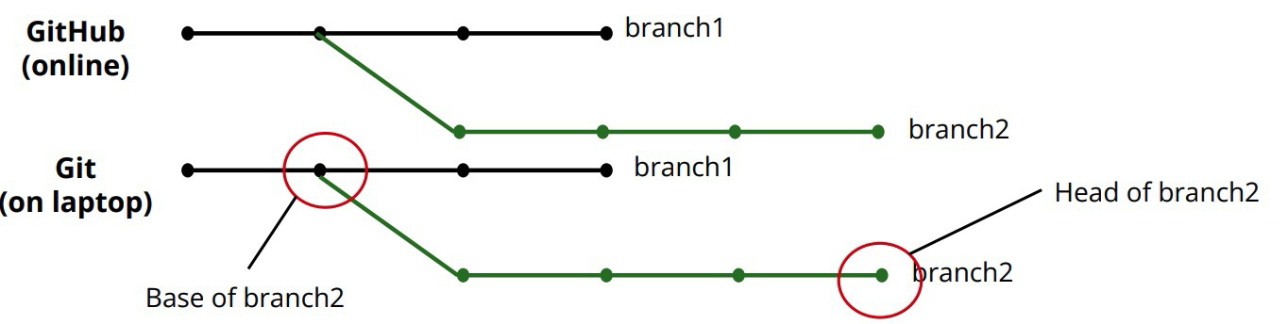
Branching
When iterating on different versions of our code base, we need:
A way to preserve both versions of the history
A way to overwrite history if we choose
Branch off a particular commit point to create a new timeline
We can push commits per branch!

Slide 6
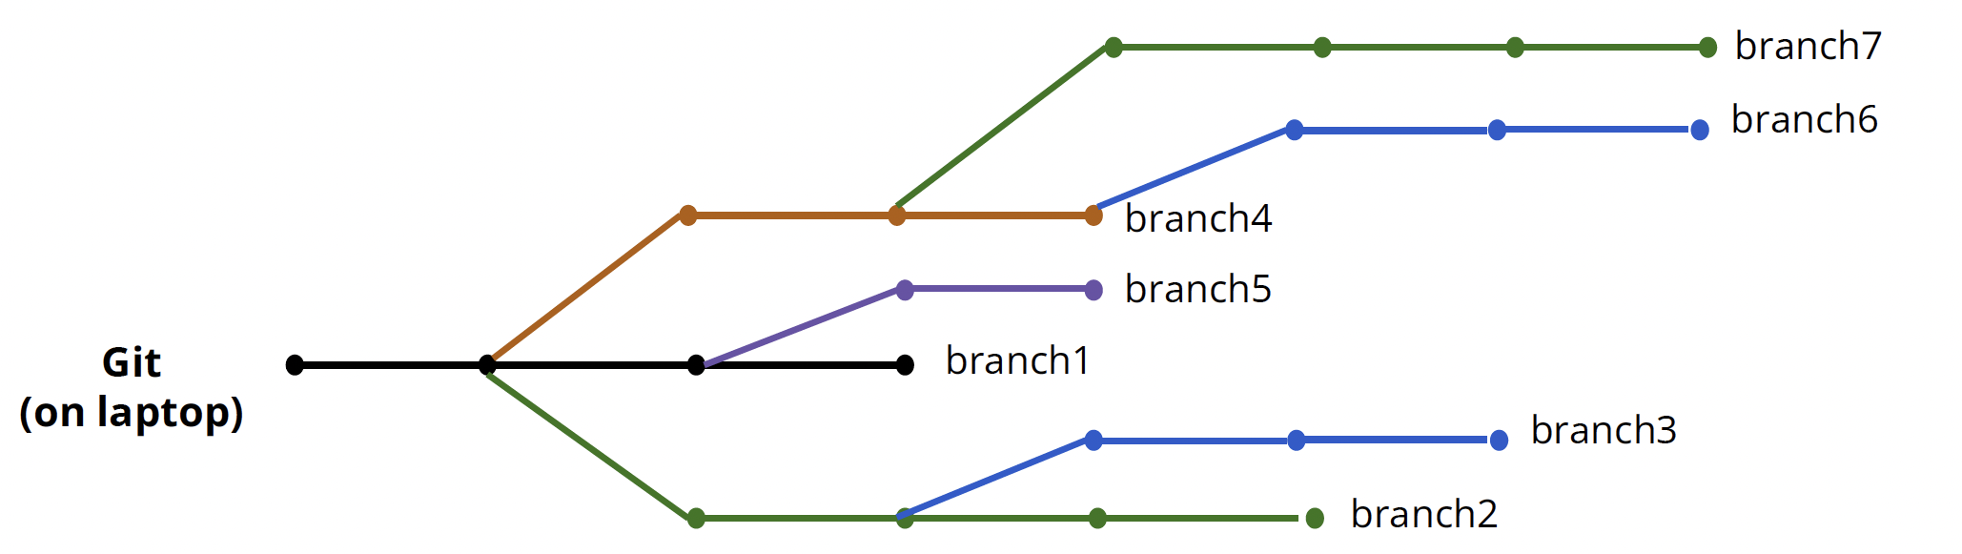
Branching
When iterating on different versions of our code base, we need:
A way to preserve both versions of the history
A way to overwrite history if we choose
Branch off a particular commit point to create a new timeline
We can push commits per branch!
We can branch off branches too!

Slide 7
Branching conventions
One branch must be chosen as the primary stable branch, typically called main
Other branches are typically named after the feature that is being developed or the major/minor version of the software/product
E.g., login-page version or v1.2 of a game
Beware! Branching can get messy. Eventually we will want to clean it up

Slide 8
Merging
At some point, we will want to clean up the branches by merging them with the master/main branch or with each other
Merging is trivial if the base of one branch is the head of the other. Changes are simply appended
In many cases, this behavior does not apply, and we will likely deal with commit conflicts a.k.a merge conflicts
A merge conflict arises when GitHub cannot automatically combine commits because they make incompatible changes to the same part of the code.
The programmer (you!) decides

Slide 9
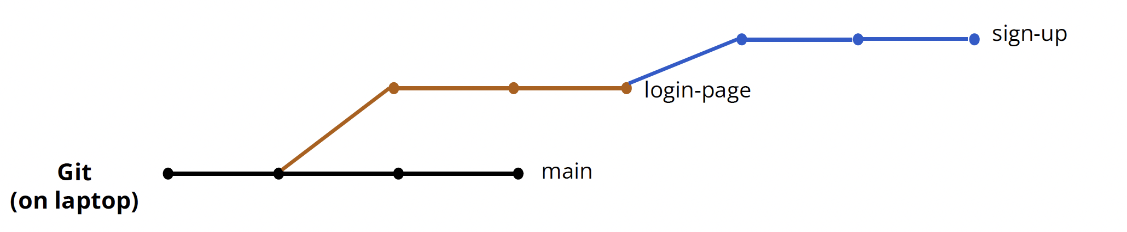
Merging
At some point, we will want to clean up the branches by merging them with the master/main branch or with each other

Slide 10
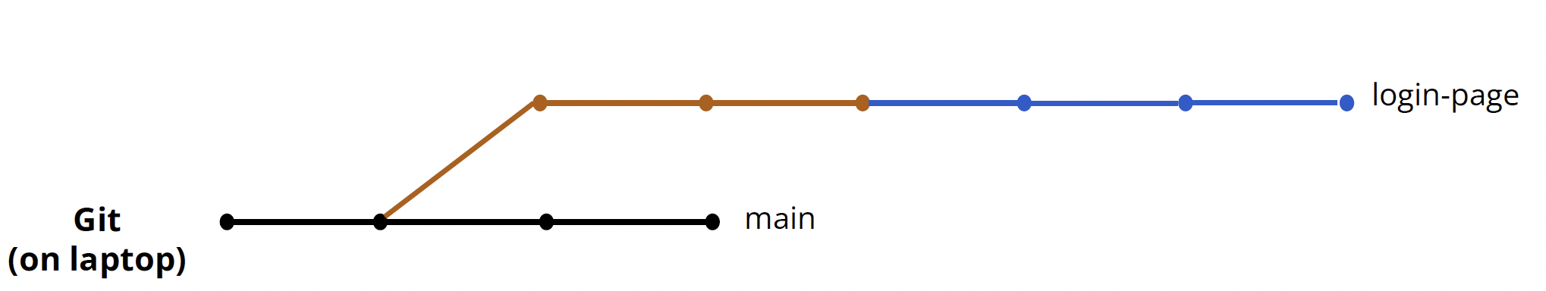
Merging
At some point, we will want to clean up the branches by merging them with the master/main branch or with each other
A merge conflict arises when GitHub cannot automatically combine commits because they make incompatible changes to the same part of the code.
The programmer (you!) decides

Slide 11
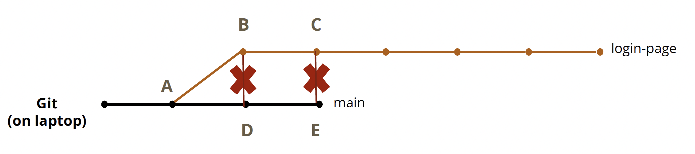
Merge conflict
It is possible that line 42 of D’s server.py is different from B’s server.py
As managers of the code base, we must resolve this conflict and decide which server.py we want so we can merge login-page with main
After we resolve, the merge conflict, what does the actual merge look like?
This is the question of rebasing

Slide 12
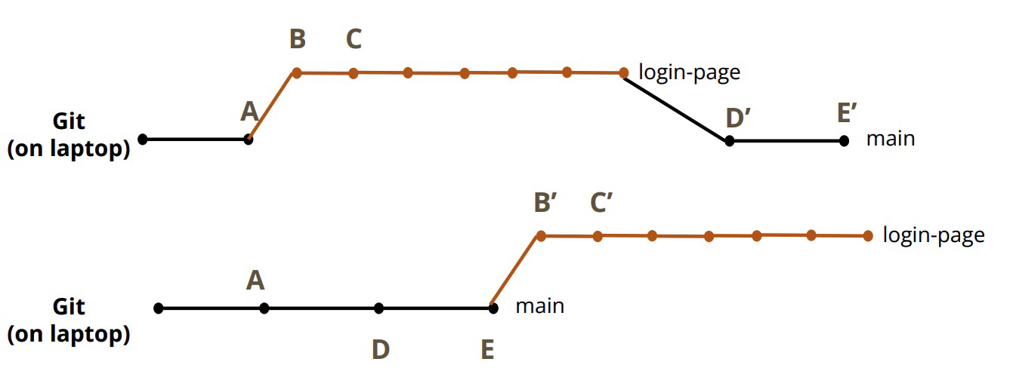
Rebasing
Option 1: Incorporate the base of login-page at the “common ancestor” of main

Slide 13
Rebasing
Option 1: Incorporate the base of login-page at the “common ancestor” of main
Option 2: Move base of login-page to head of main

Slide 14
Collaboration
Other repositories can be thought of as other branches
SOP for collaborators to contribute code:
Collaborator makes a copy of (forks) the main repository
Collaborator makes changes on their fork
Collaborator requests that part of their copy be merged into the main repository via a pull request (PR)
This is the standard (almost) everywhere!

Slide 15
Collaboration best practices
Pull the latest early and often
i.e., retrieve the latest changes from the main repository
Always create a new branch when developing on a forked repository. Avoid committing directly to main
This makes it easier to keep your main branch in sync with the main repository
Keep branches short-lived: merge after a few days vs. after weeks
Commit frequently and meaningfully
Detailed commit messages aren’t just so you get full points on your programming assignment!

Slide 16
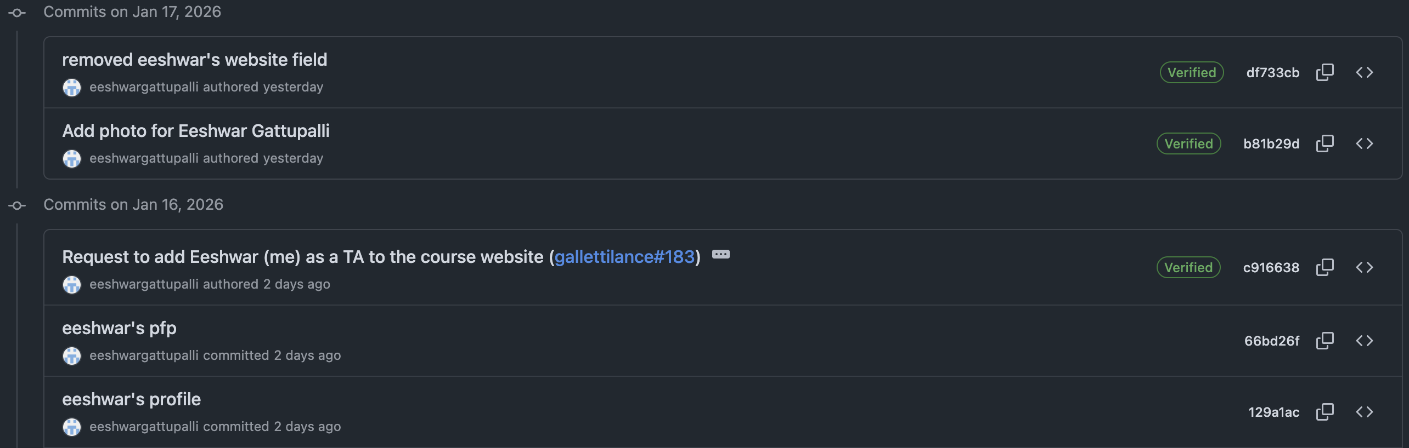
Collaboration best practices
Commit frequently and meaningfully
Detailed commit messages aren’t just so you get full points on your programming assignment!
PR message!

Slide 17
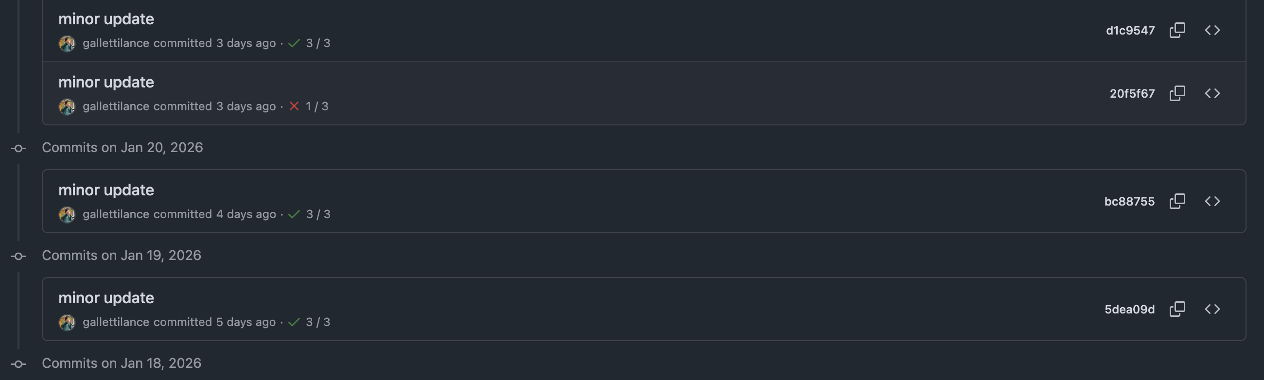
Not so great commit messages!!
As a developer or collaborator, this commit message tells me nothing!

Slide 18
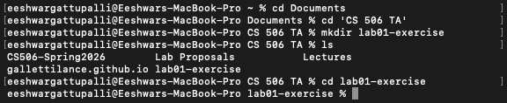
How to actually use Git and GitHub?
Use your terminal to navigate to the directory where you want to develop
Now that you’re in the desired destination, you can begin using Git commands!
Change directory: equivalent of opening a folder in your file explorer/finder
Make directory: equivalent of creating a new folder
List: list all the contents of the current directory that you’re in

Slide 19
Git commands: Local operations
Basic commands
git init
Initialize a new repository (locally)
git add <file-name1> <file-name2> … <file-nameN>
Promotes changes from your working directory to the stages area. Tells Git which files you want to include in the next commit
git commit –m “amazing commit message ☺”
Saves the changes you’ve staged (from git add) as a permanent point in the repository’s timeline, like a snapshot!
Annotates the snapshot with your amazing commit message

Slide 20
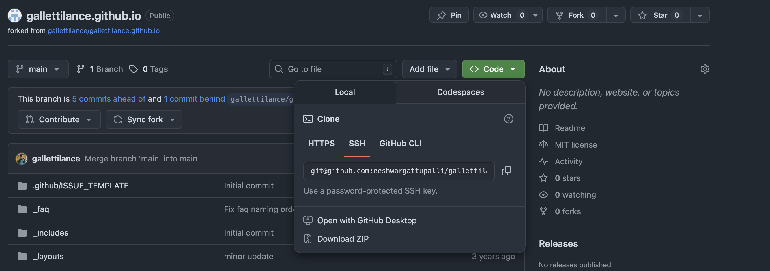
Git Commands: Linking to GitHub
Linking your local repository to a GitHub repository
git remote add origin <SSH URL>
Adds a ”remote” that points to a GitHub repository (identified by the SSH)
Once you create an empty repository on GitHub (without README, .gitignore, and license), copy the SSH URL and paste in the command above

Slide 21
Git Commands: Interacting with GitHub
Pushing to GitHub repository!
After staging your changes locally (utilizing git add and git commit), enter git push origin main
Pushes stages changes to the main branch of the GitHub repository being pointed to by the remote
After forking the main repository (for collaborative efforts!)
git clone <forked-repo-SSH-link>
Locally clone the forked repository
git remote add upstream <main-repo-SSHLink>
Connect your forked repository to the original project
git fetch
Download most recent changes from remote (original) repository
git pull upstream main
Download most recent changes from remote (original) repository and apply to current local branch
git push origin main (after staging)
Push to forked repo

Slide 22
Git Commands: Branching
Creating and operating on new branches
git checkout –b my-new-branch
Creates a new branch then switches to it
git branch my-new-branch
Creates a new branch without switching to it
git switch my-new-branch
Switch to existing branch
git push -u origin my-branch
Creates origin/my-branch on linked GitHub repository
Links local my-branch to origin/my-branch
At this point, if you stage files and run git push, Git will push the staged files to origin/my-branch
If you run git switch main, stage your files, then push, Git will push to main. Git always pushes to the current branch!

Slide 23
Git Commands: Merging/Rebase
Merge: While on feature branch…
git merge main
Bring main’s history in the current branch. Essentially collapses the commit history from main into the current branch.
git merge –abort
Abort a merge with conflicts
Rebase: While on feature branch…
git rebase main
Moves base of current branch to head of main

